Slide 1
Advanced Programming
Module Project
Module: Web Development Using Platforms
Start Date : 9 March 2023
End Date : 6 April 2023
Submission Date :
Learner Name : Agung Yuda Pratama
Enrollment ID : BDSE0922-076
Presentation Date :

Slide 2
Contents
Contents
S. No. | Description
01 | List of software used
02 | OO Paradigm
03 | Class Relationships
04 | Class Diagram
05 | Developing Triple A portlet
06 | Customer Management Portlet
07 | Design Patterns
08 | Creational Design Patterns
09 | Structural Design Patterns
10 | Behavioural Design Patterns
11 | Project Results

Slide 3
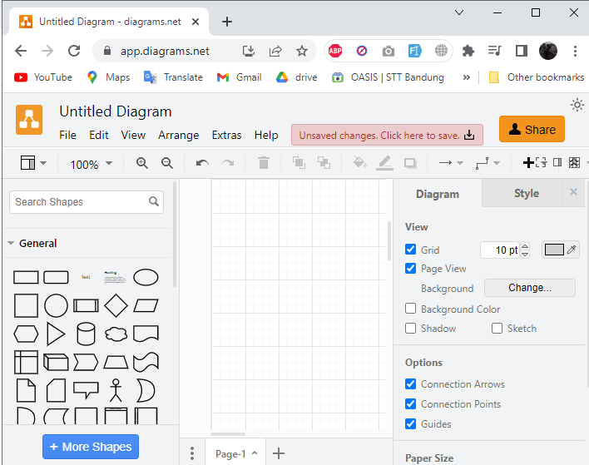

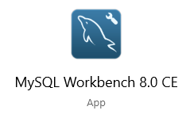
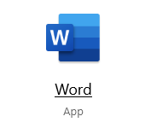
1. List of software used

Slide 4
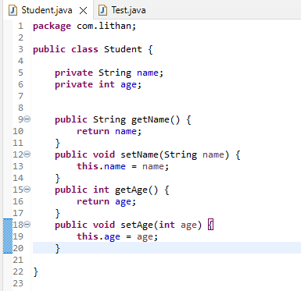
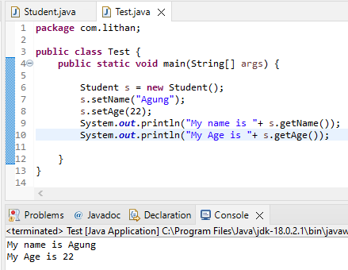
2. Object Oriented Paradigm
Encapsulation
is the wrapping of data or hiding personal data from an object so that it cannot be accessed from other objects. Can only access using the current class, getter and setter methods.

Slide 5
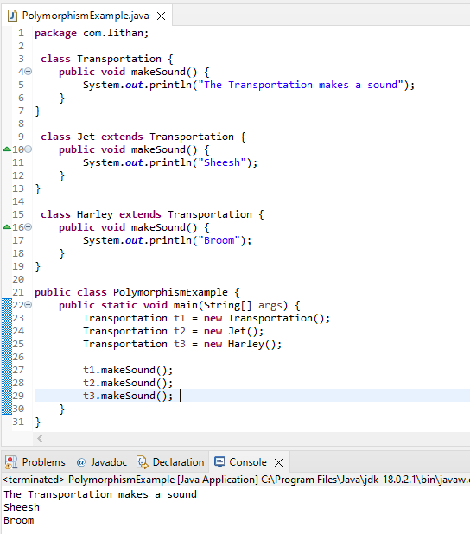
2. Object Oriented Paradigm
Polymorphism
consists of two syllables, poly means many and morphism comes from the word morph means form. So that polymorphism in OOP programming is a term that explains that a class can have more than one method name that is the same with different contents or method bodies.

Slide 6
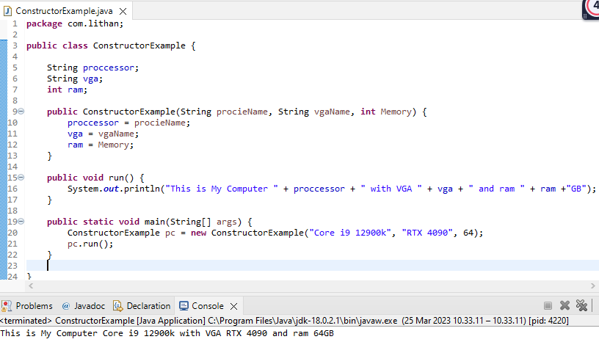
2. Object Oriented Paradigm
Constructor
Constructor is a special method that is used for initialization when creating an object. The constructor is called as soon as the new object is created. The feature of the constructor is that the method name exactly matches the class name.

Slide 7
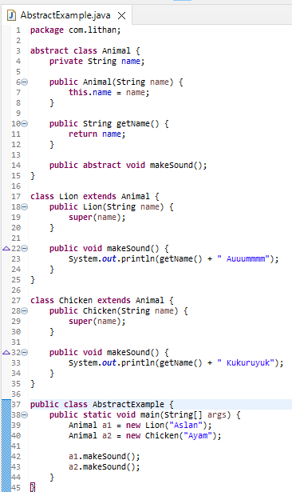
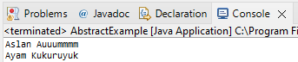
2. Object Oriented Paradigm
Abstract
Abstract is a declaration without providing details on what is declared. Abstract can be implemented in classes or methods using the abstract keyword. The opposite of abstract is concrete (concrete) where classes and methods are declared along with their details clearly.

Slide 8
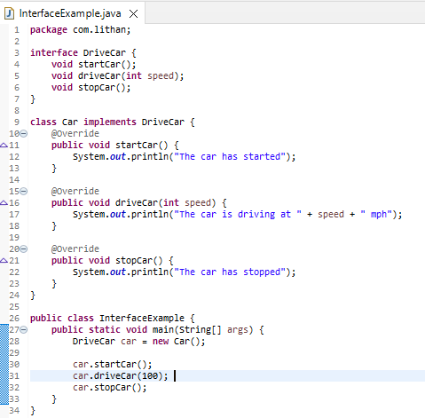
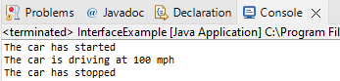
2. Object Oriented Paradigm
Interface
The interface is a class-like form in which it consists of a collection of empty methods and constants. Interfaces cannot be made objects but can only be implemented. If the class declares an object, then the interface generally expresses capabilities such as Readable, Runnable, Comparable, etc.

Slide 9
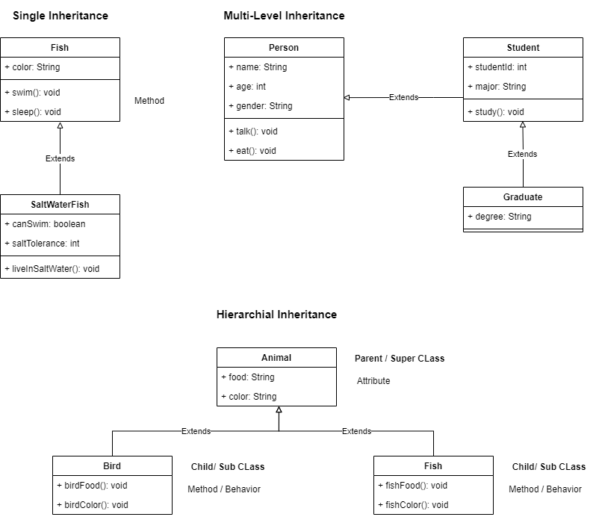
3. Class Relationships
Inheritance
The is a relationship between two classes, primarily the parent class and the child class, which inherits the parent's structure and behavior, is represented by inheritance, also known as generalization. A solid line arrow clearly illustrates the relationship (hollow arrowhead).

Slide 10
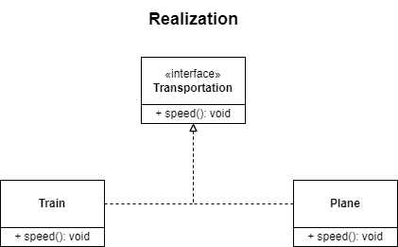
3. Class Relationships
Realization
Realization is seen in interfaces when the blueprint class is paired with an object to carry out each detail. A dashed line with a hollow arrowhead can be used to indicate a relationship.

Slide 11
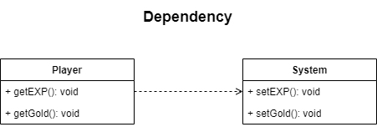
3. Class Relationships
Dependency
Dependency is when class A is dependent on class B. Therefore, when class B changes, class A will also be affected by the change. A dashed line with an open arrow can represent this relationship

Slide 12
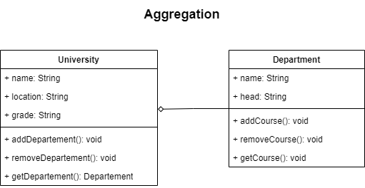
3. Class Relationships
Aggregation
Aggregation is the single point of control where it aggregates or assembles a group of objects that is part of the object which aggregate. The part of the relationship can be represented by a solid line with an unfilled diamond at the parent end connected to the child class. In this case, if the parent is deleted, the child class can still exist independently.

Slide 13
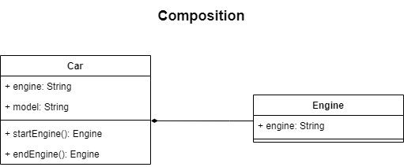
3. Class Relationships
Composition
Composition is the stronger form of aggregation. In this case, if the source or the aggregator is destroyed, then part of it is also destroyed with it and cannot stand by itself. The relationship is displayed with a solid line and the filled diamond at the associated/source end connected to the composite class.

Slide 14
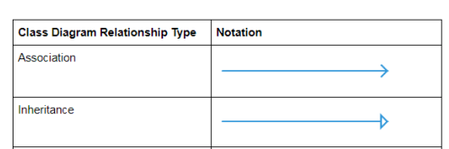
3. Class Relationships
Class relationships which are used in project scenario.
1. Inheritence :
Administrators, Site Members, and customer classes have common variables and methods, they all use inheritance from the User, a new super class with generic variables and methods.
2. Association :
Administrators can only manage customers and site members, and site members can only handle customers, so the relationship between administrators and customers, administrators and site members, and site members and customers is unidirectional.

Slide 15
4. Class Diagram
What is Class Diagram
A class diagram is an effective tool for describing different Design Patterns. In many instances, a class diagram is required to represent the crucial elements of a specific pattern completely. This is due to the fact that a class diagram offers a thorough depiction of a system's static structure while emphasizing key connections between classes, objects, characteristics, and activities.
Modifiers are used to indicate visibility of attributes and operations.
1. ‘+’ is used to denote Public visibility (everyone)
2. ‘#’ is used to denote Protected visibility (friends and derived)
3. ‘-’ is used to denote Private visibility (no one)
By default, attributes are hidden and operations are visible.

Slide 16
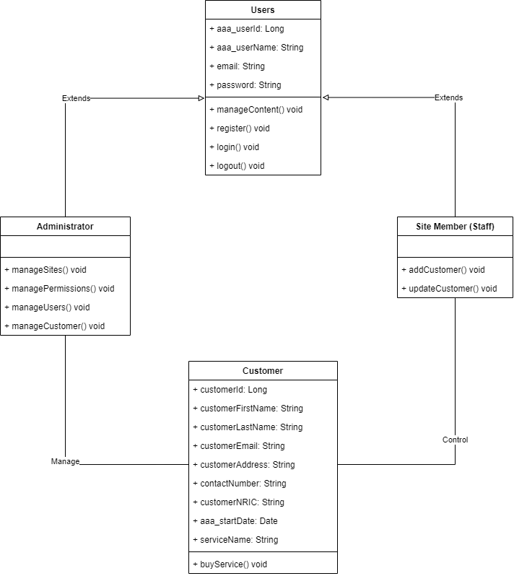
4. Class Diagram

Slide 17
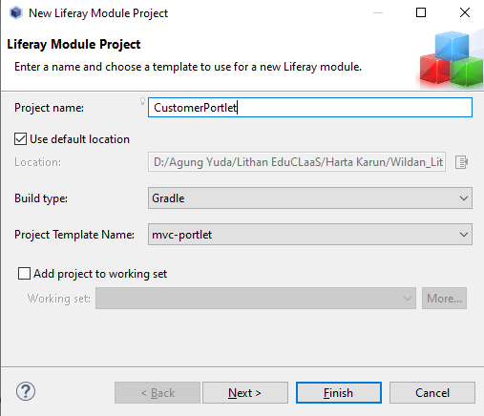
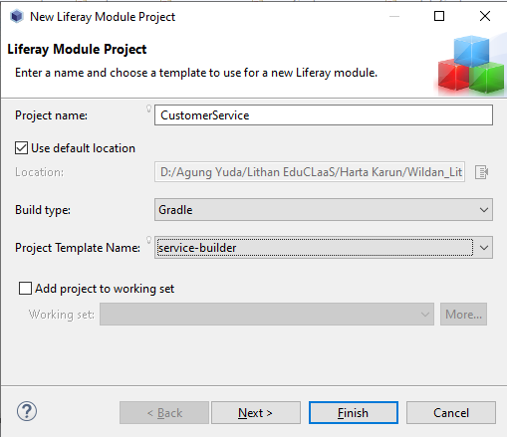
5. Developing Triple A portal
Create MVC Portlet
Create new modules on liferay workspace

Slide 18
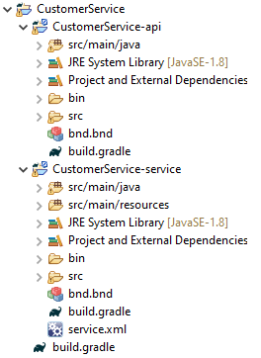
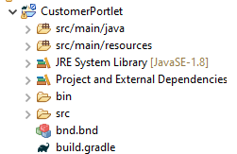
Result

Slide 19
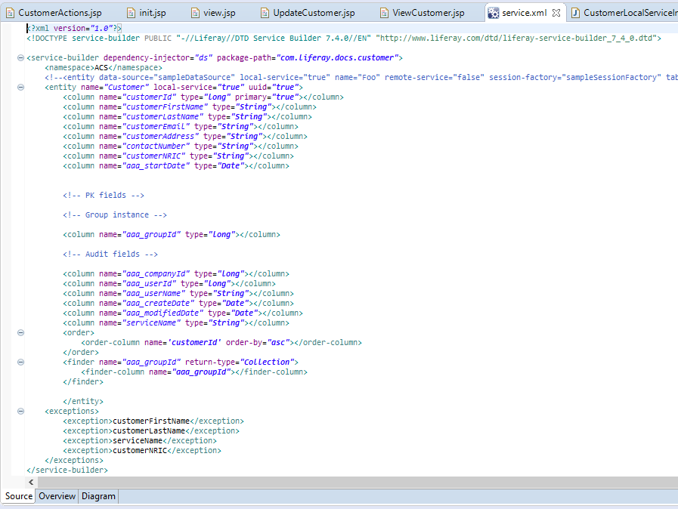
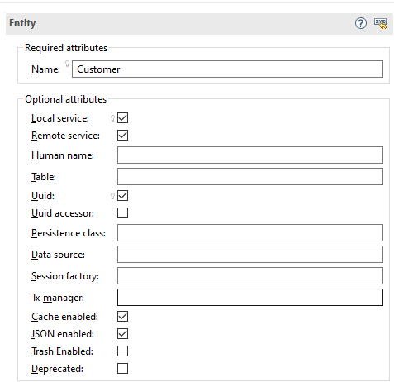
5. Developing Triple A portal
Create Customer Entity

Slide 20
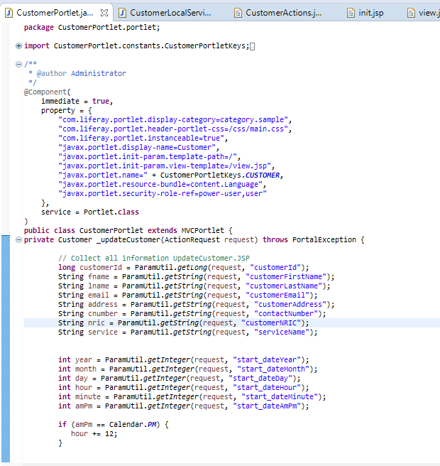
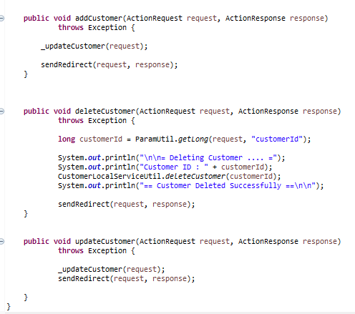
5. Developing Triple A portal
Coding screen captures

Slide 21
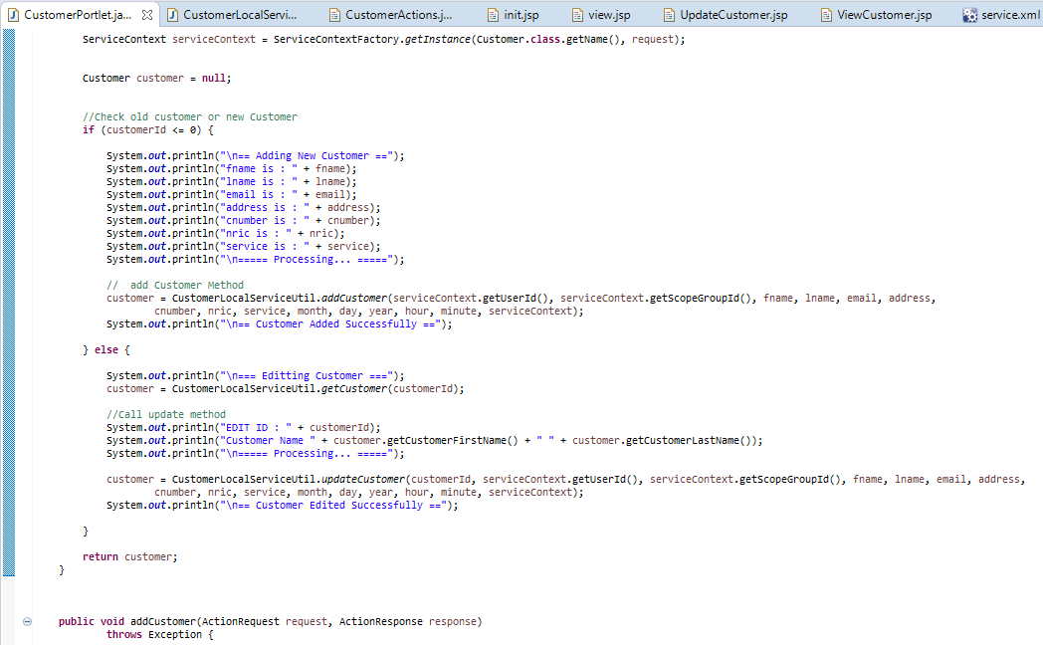
5. Developing Triple A portal

Slide 22
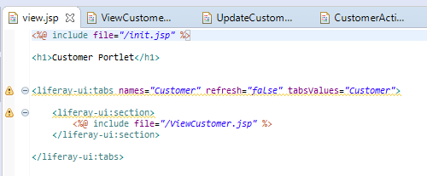
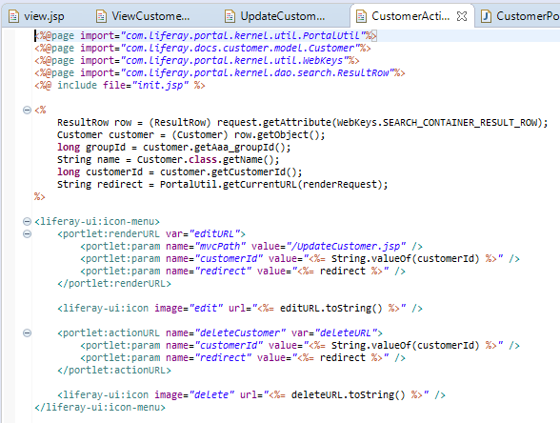
5. Developing Triple A portal

Slide 23
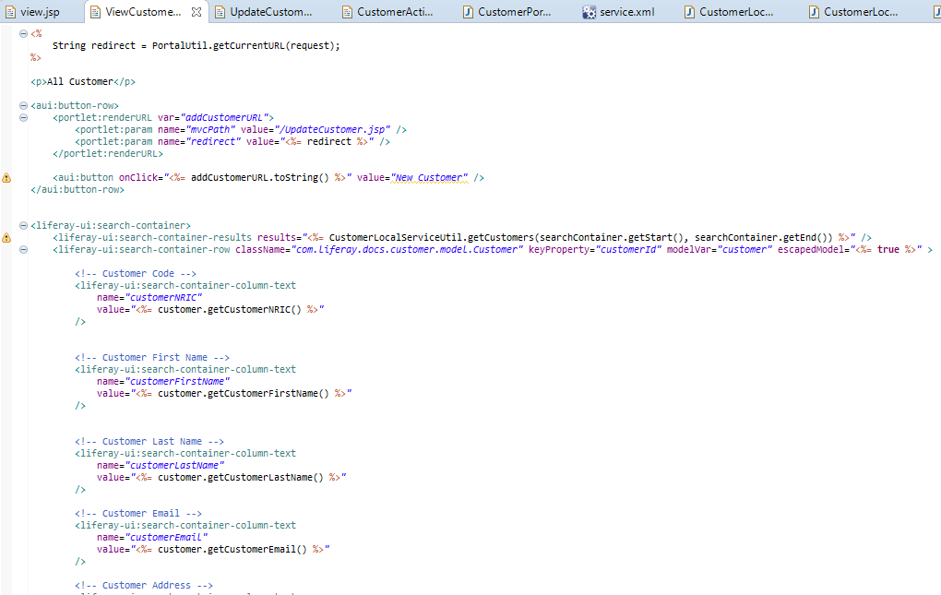
5. Developing Triple A portal

Slide 24
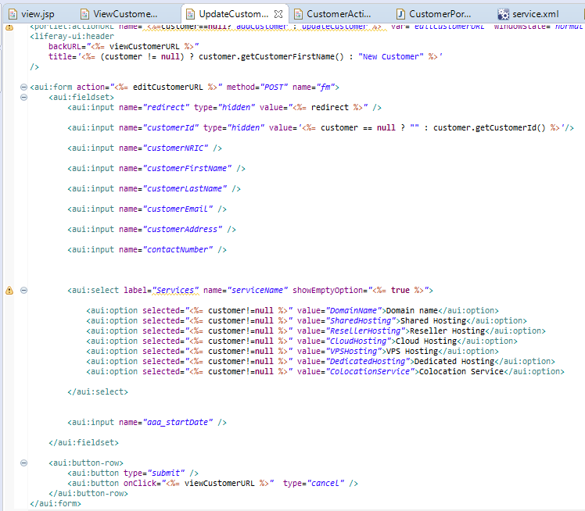
5. Developing Triple A portal

Slide 25
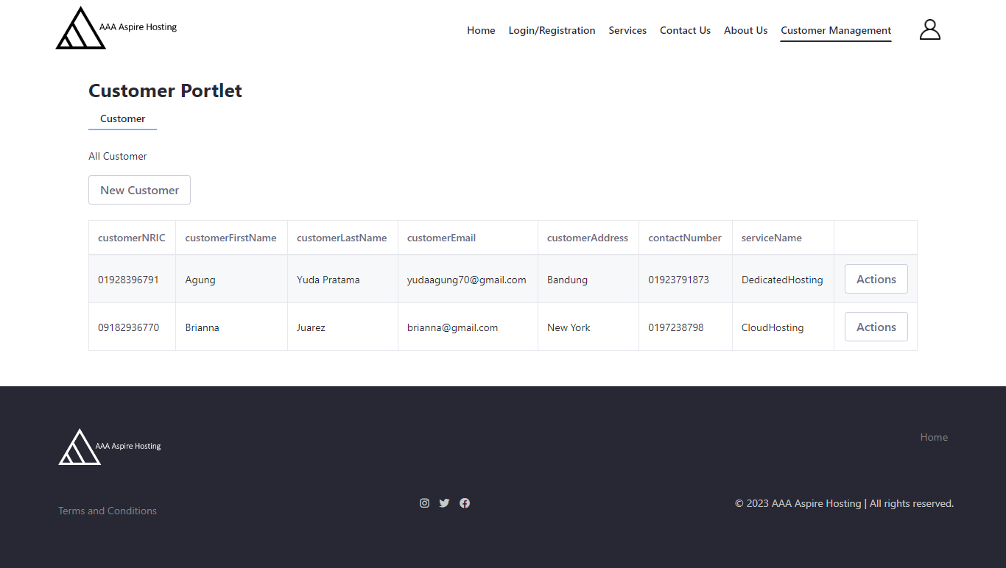
6. Customer Management Portlet

Slide 26
7. Design Patterns
Definition of Design Pattern
Design pattern is a general repeatable solution to common problems. It is a template to create solution for various situations that corelate

Slide 27
8. Creational Design Patterns
What is creational design pattern?
The process of making objects is the focus of creational design patterns. When a choice needs to be made during the instantiation of a class, these design patterns are employed (i.e. creating an object of a class).
The Most suitable design pattern for AAACustomer Portlet is The Factory Method Patern.

Slide 28
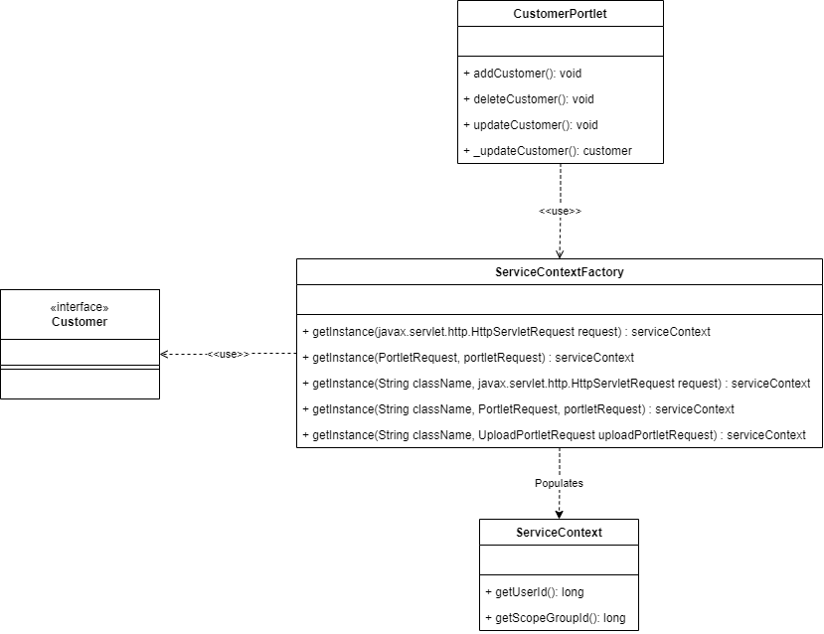
8. Creational Design Patterns

Slide 29
9. Structural Design Patterns
What is structural design pattern?
A structural design pattern is a guide for combining various objects and classes to create a larger structure that can accomplish several objectives at once. The patterns in structural designs demonstrate how distinctive system components can be put together in a flexible and extensible way.
The Most suitable design pattern for AAA Customer Portlet is The Facade Patern.

Slide 30
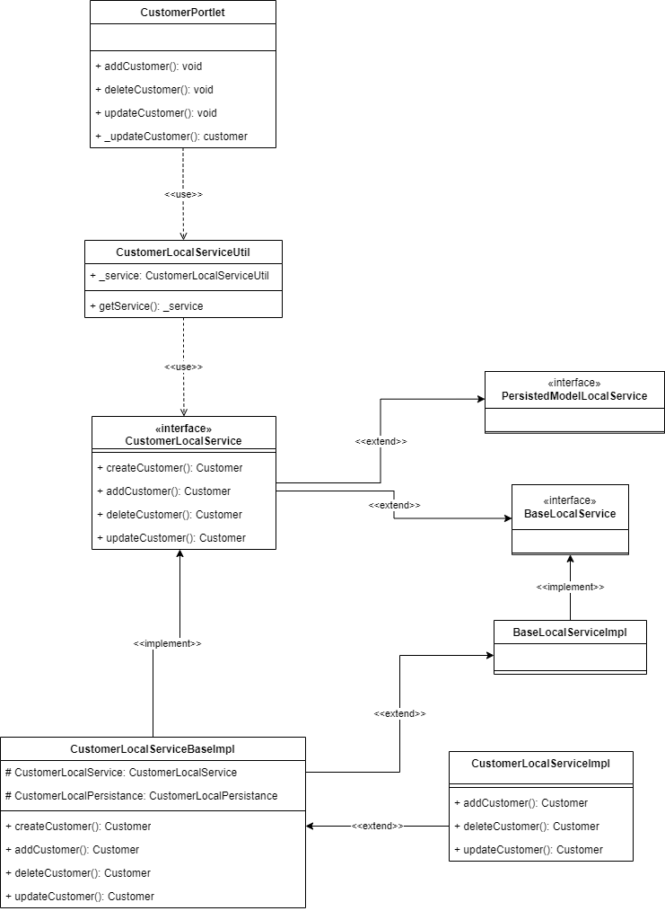
9. Structural Design Patterns

Slide 31
10. Behavioural Design Patterns
What is behavioral design pattern?
Behavioral design patterns are concerned with the interaction and responsibility of objects. These design patterns call for the interaction of the items to be loosely connected while still allowing for easy communication between them.This means that in order to prevent hard coding and dependencies, the implementation and the client should be loosely connected.
The Most suitable design pattern for AAA Customer Portlet is The Template Patern.

Slide 32
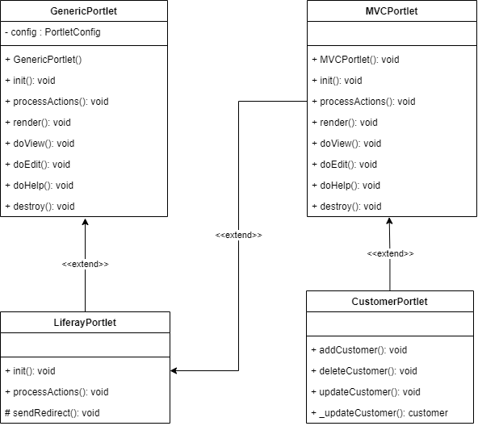
10. Behavioural Design Patterns

Slide 33
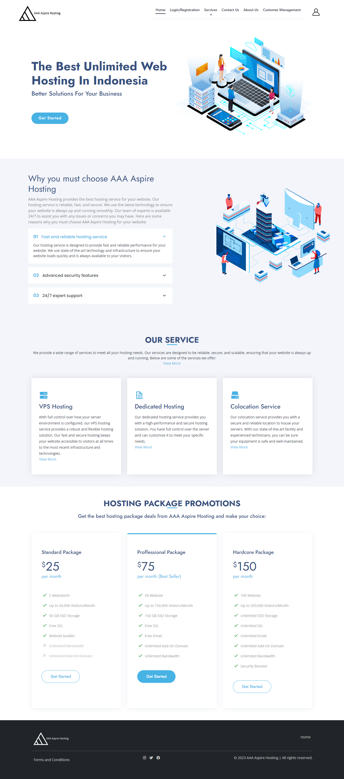
11. Project Result
Homepage

Slide 34
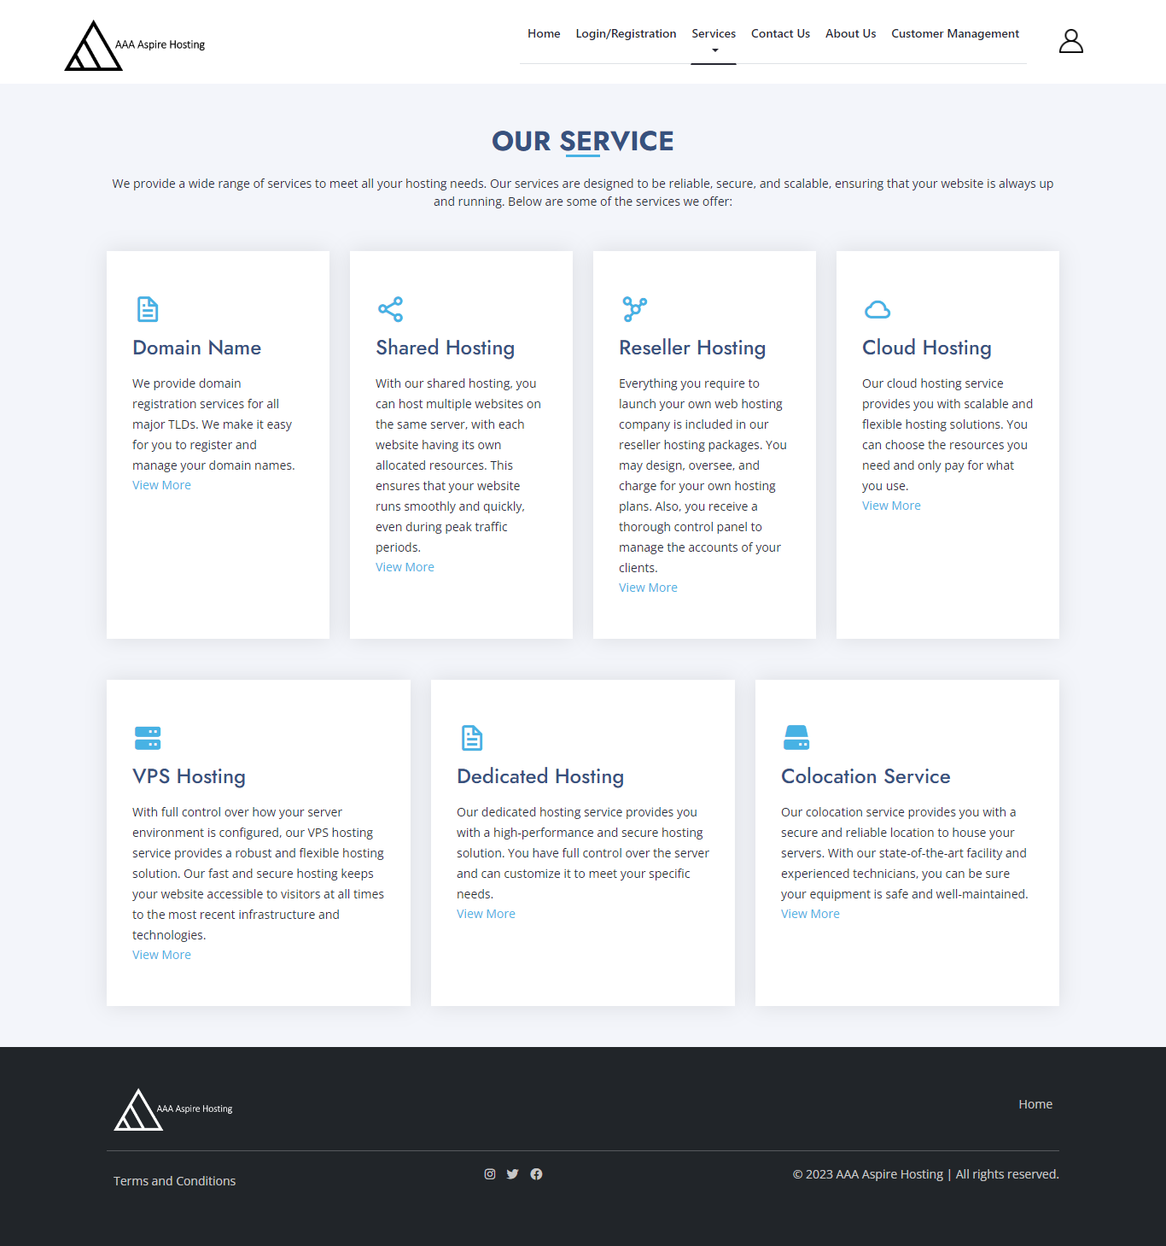
11. Project Result
Services

Slide 35

11. Project Result
Domain Name Service

Slide 36

11. Project Result
Shared Hosting Service

Slide 37
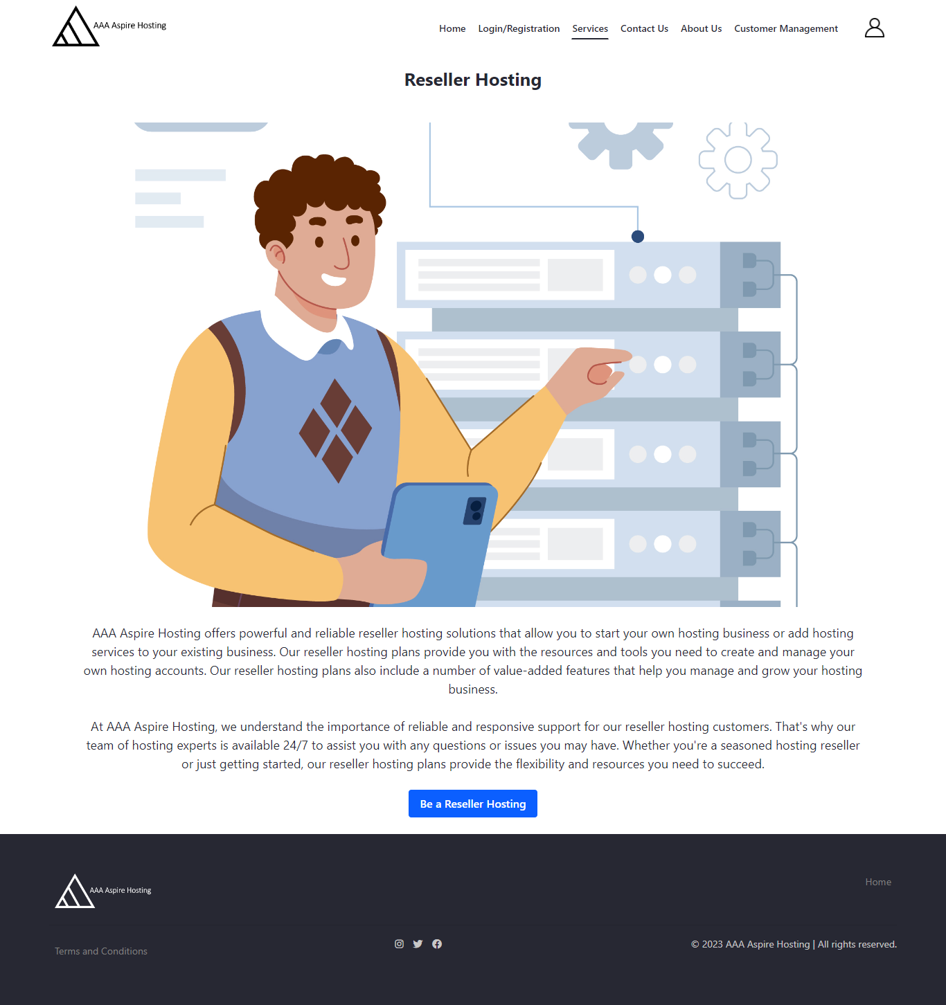
11. Project Result
Reseller Hosting Service

Slide 38
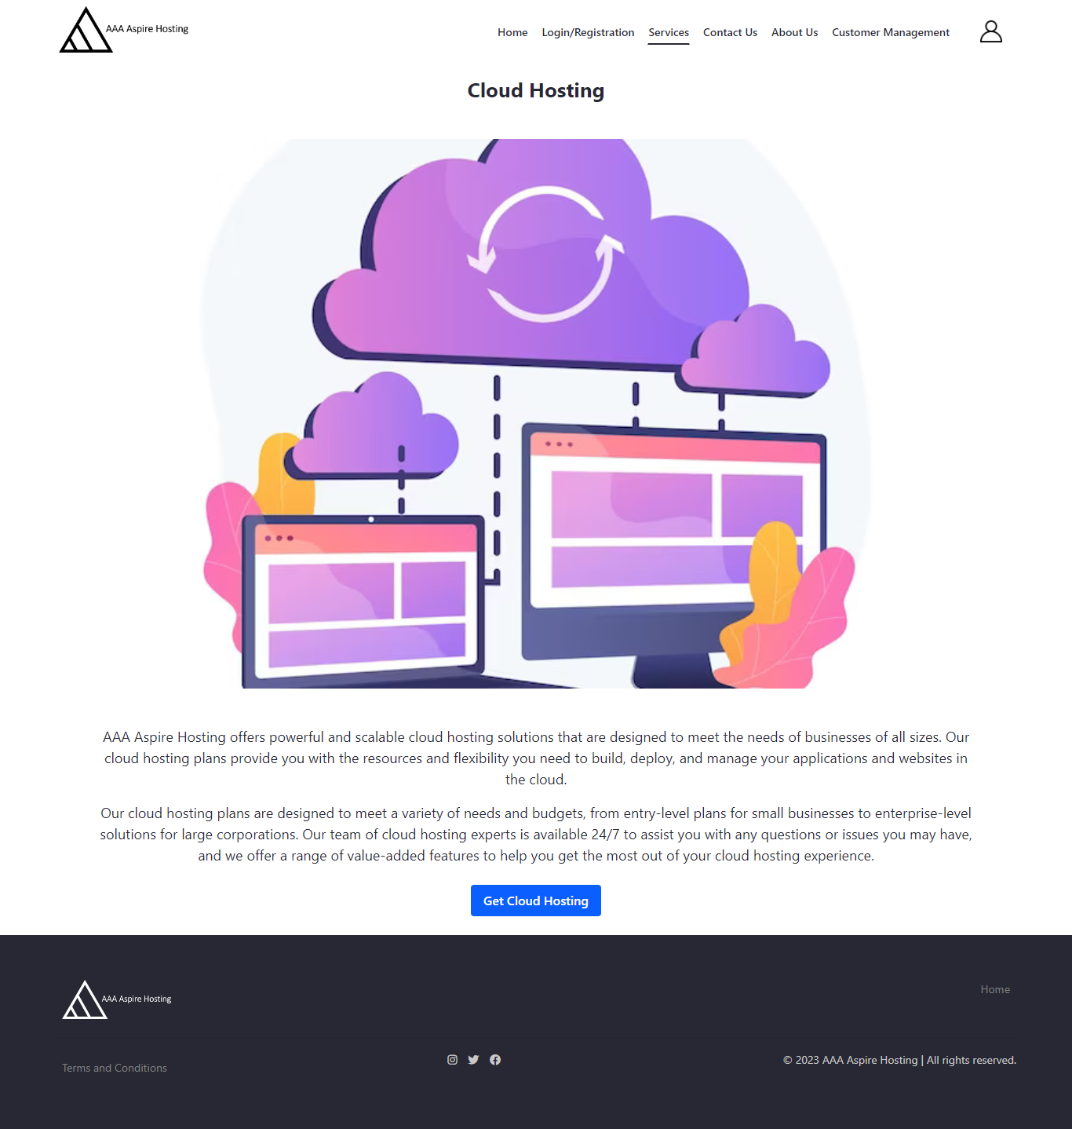
11. Project Result
Cloud Hosting Service

Slide 39

11. Project Result
VPS Hosting Service

Slide 40
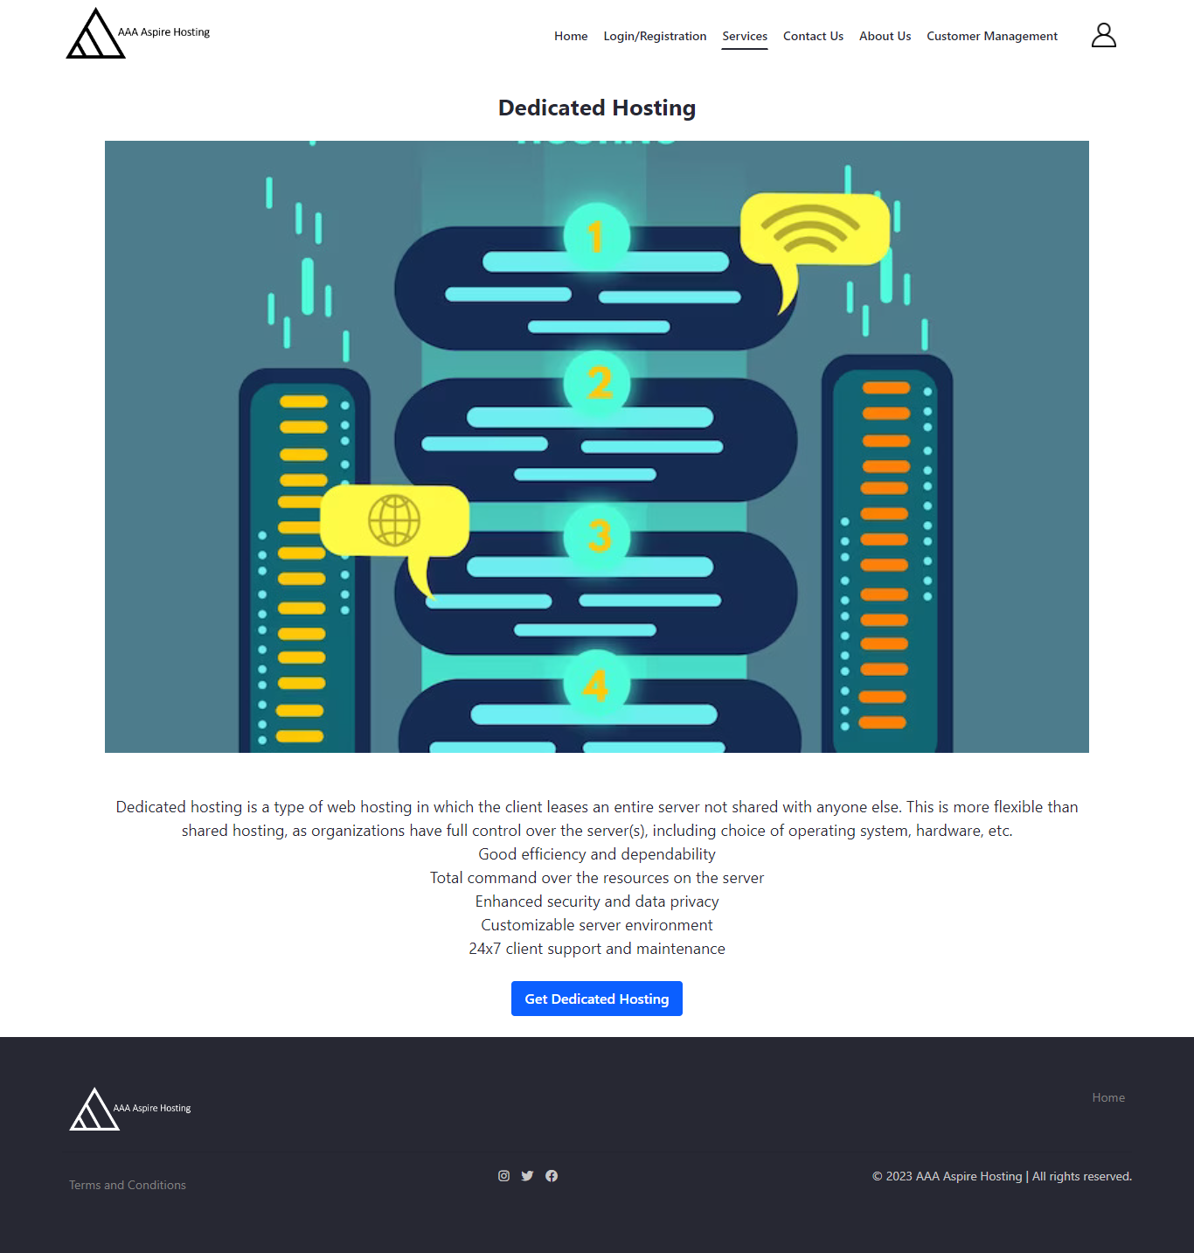
11. Project Result
Dedicated Hosting Service

Slide 41

11. Project Result
Colocation Service

Slide 42
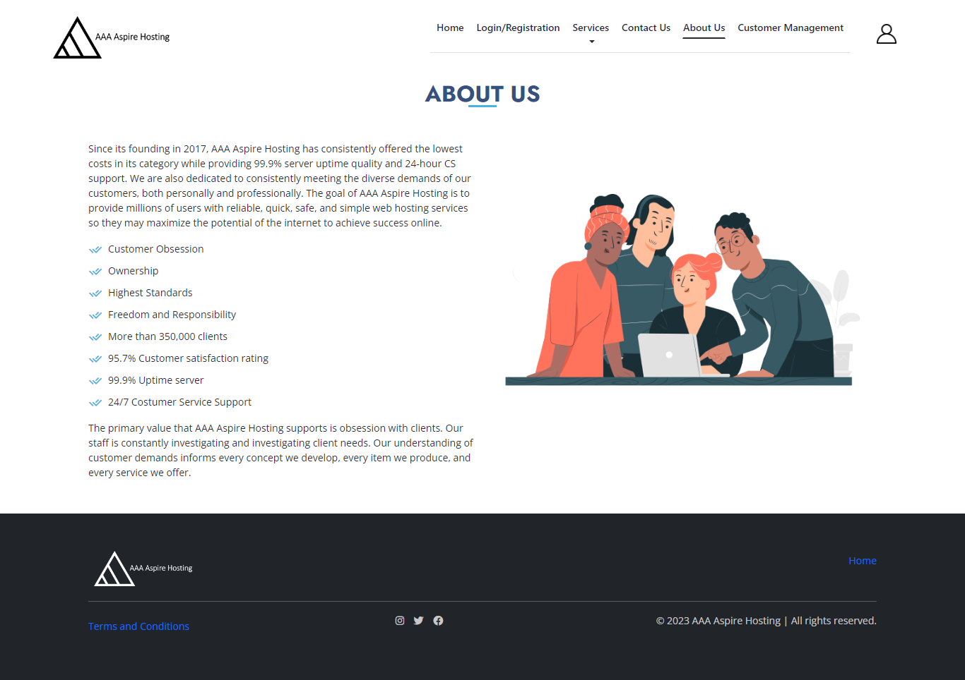
11. Project Result
About Us Page

Slide 43
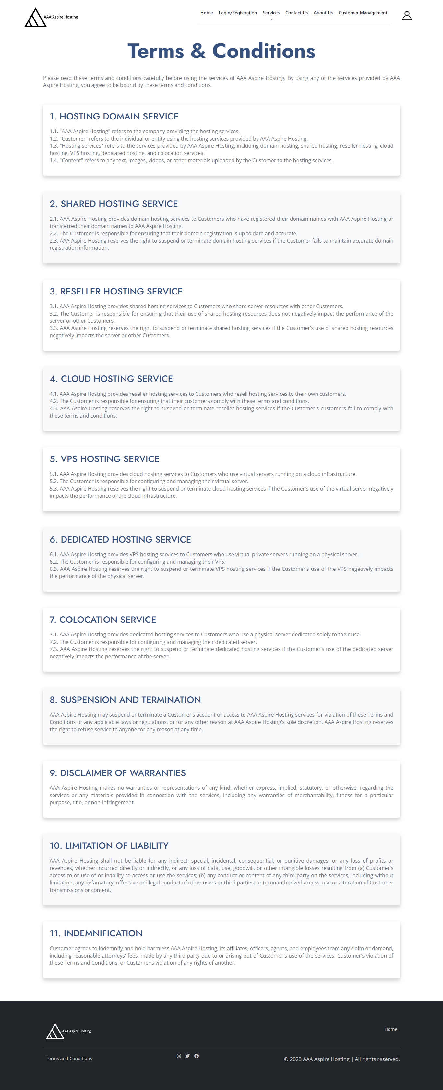
11. Project Result
Terms and Conditions Page

Slide 44
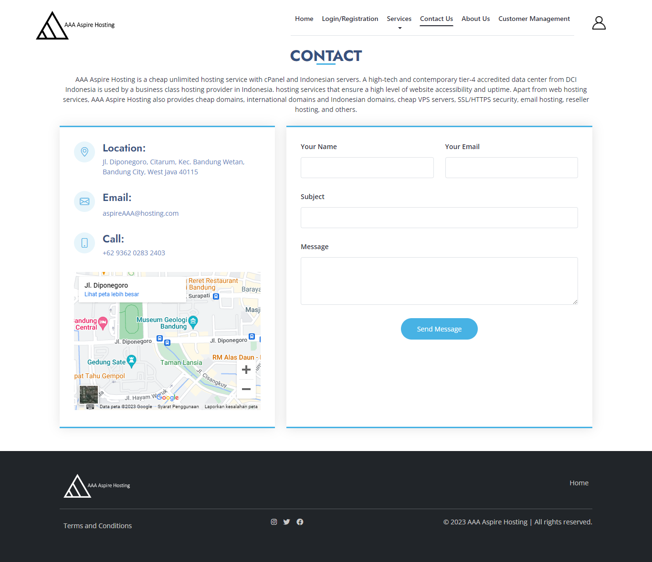
11. Project Result
Contact Us Page

